Slide 1
Matthew 28:1-10 (NIV)
1After the Sabbath, at dawn on the first day of the week, Mary Magdalene and the other Mary went to look at the tomb. 2 There was a violent earthquake, for an angel of the Lord came down from heaven and, going to the tomb, rolled back the stone and sat on it. 3 His appearance was like lightning, and his clothes were white as snow. 4 The guards were so afraid of him that they shook and became like dead men. 5 The angel said to the women, "Do not be afraid, for I know that you are looking for Jesus, who was crucified.

Slide 2
Matthew 28:1-10 (NIV)
6 He is not here; he has risen, just as he said. Come and see the place where he lay. 7 Then go quickly and tell his disciples: 'He has risen from the dead and is going ahead of you into Galilee. There you will see him.' Now I have told you." 8 So the women hurried away from the tomb, afraid yet filled with joy, and ran to tell his disciples. 9 Suddenly Jesus met them. "Greetings," he said. They came to him, clasped his feet and worshiped him. 10Then Jesus said to them, "Do not be afraid. Go and tell my brothers to go to Galilee; there they will see me."

Slide 3
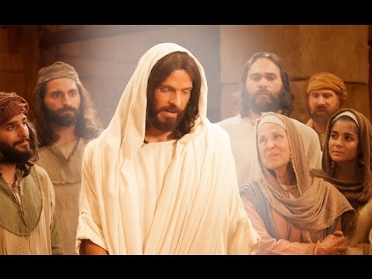
Resurrected Jesus What did He say?
Easter Sunday 10am
17th April Kay Brown

Slide 4
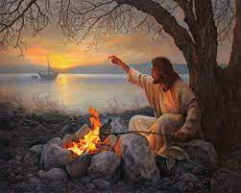
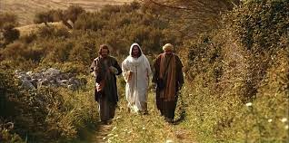
Resurrected Jesus What did He say?

Slide 5
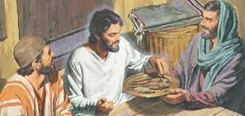
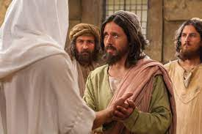
Resurrected Jesus What did He say?
1 Corinthians 15:3-8
All the people Jesus spent time with,
Over 500 at
one place

Slide 6
Resurrected Jesus What did He say?
Matthew 28
Mark 16
Luke 24
John 20-21
Acts 1
1 Corinthians 15:3-8

Slide 7
Resurrected Jesus What did He say?
Do not be afraid
Matthew 28:10
Luke 24:36-39 Peace to you
Why? Because He lives

Slide 8
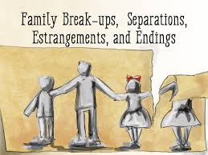
Resurrected Jesus What did He say?
Do not be afraid
Matthew 28:10
Luke 24:36-39 Peace to you
Why? Because He lives

Slide 9
Resurrected Jesus What did He say?
Be a witness
John 20:21 As the Father has sent me, so I send you
Matthew 28:19 Go and make disciples of all nations
Acts 1:8 You shall be witnesses to me … to the ends of the earth

Slide 10
Resurrected Jesus What did He say?
Be a witness
John 20:21 As the Father has sent me, so I send you
Matthew 28:19 Go and make disciples of all nations
Acts 1:8 You shall be witnesses to me … to the ends of the earth

Slide 11
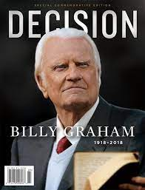
Resurrected Jesus What did He say?
Be a witness
Billy Graham
“ I am convinced that if we really believed that
men and women are lost apart from Jesus Christ,
it would become a burning incentive to evangelize
with a zeal and a passion that we are in danger
of losing.”
Decision Magazine April 17, 2014

Slide 12
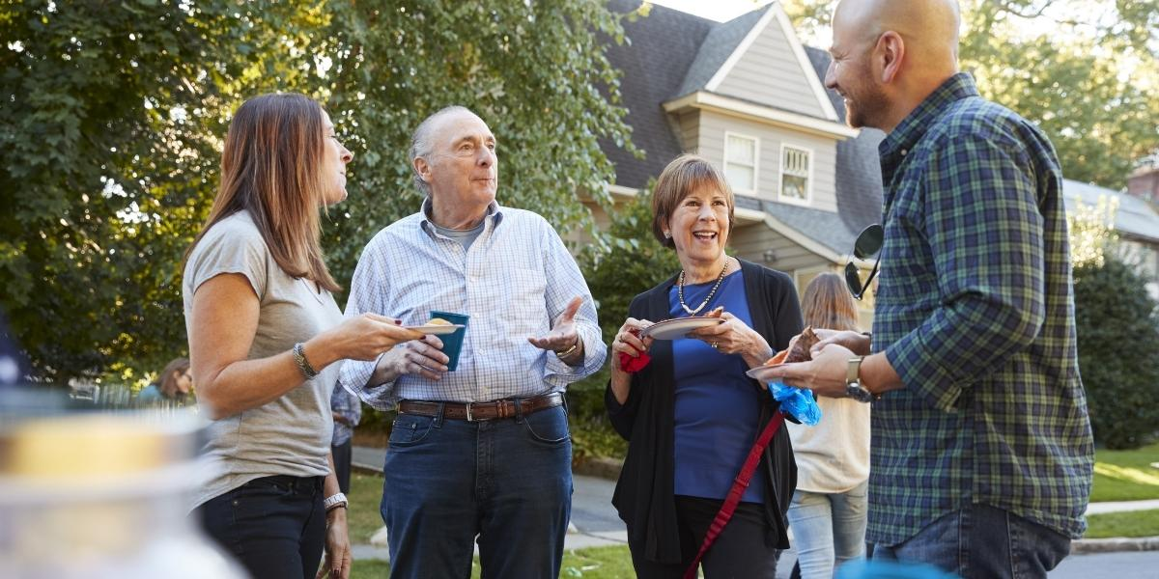
Let’s Get Neighbourly, Maroondah
Let’s Get Neighbourly is an initiative that aims to increase local connections between neighbours.
Training will be provided in the form of two workshops, held at our Community Houses. The workshops will include one-to-one mentoring, and Experienced Connectors, who will share their wealth of knowledge to make your event a success.

Slide 13
Ringwood Community Church
Monday Peter and Kay Brown - Ringwood
Wednesday Phil and Meryl Adams – Warranwood
Wednesday Sarosh Samuel – Kilsyth South
Thursday Greg and Heather Mellow – Mitcham
Friday Liz and Liam Pirie – Box Hill

Slide 14
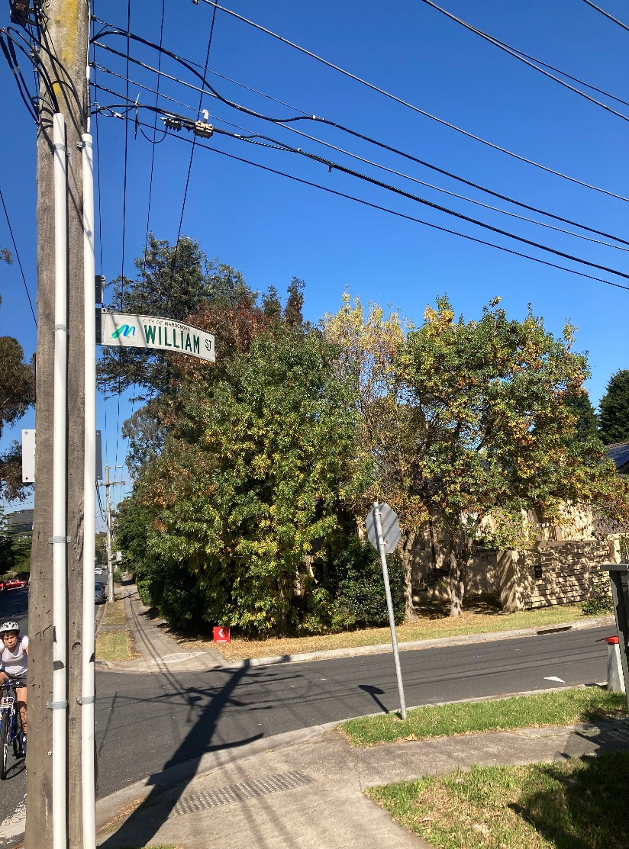
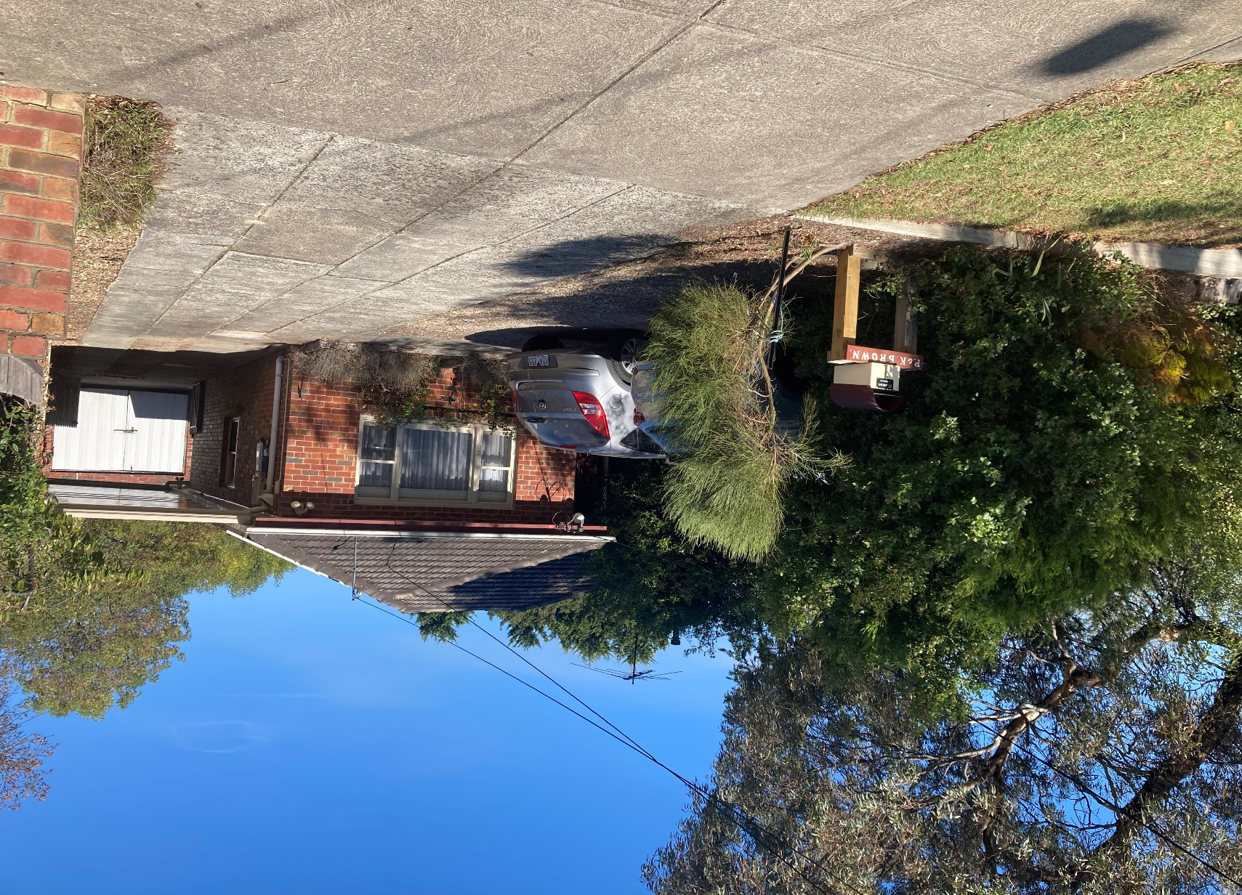
Resurrected Jesus What did He say?
Be a witness

Slide 15
Resurrected Jesus What did He say?
Receive power
John 20:22 Receive the Holy Spirit
Acts 1:8 You shall receive power when the Holy Spirit has come upon you

Slide 16
Resurrected Jesus What did He say?
Do not be afraid
Be a witness
Receive power

